Slide 1
Movie Rental Analysis
Sakila DVD Rental Store By Hemant Goswami

Slide 2

Introduction
This analysis aims to delve into the dynamics of a DVD rental store, examining various aspects such as customer behavior, film popularity, rental trends, and geographic patterns. By exploring and interpreting the available data, we seek to uncover actionable insights that can inform strategic decision-making and drive business growth.

Slide 3
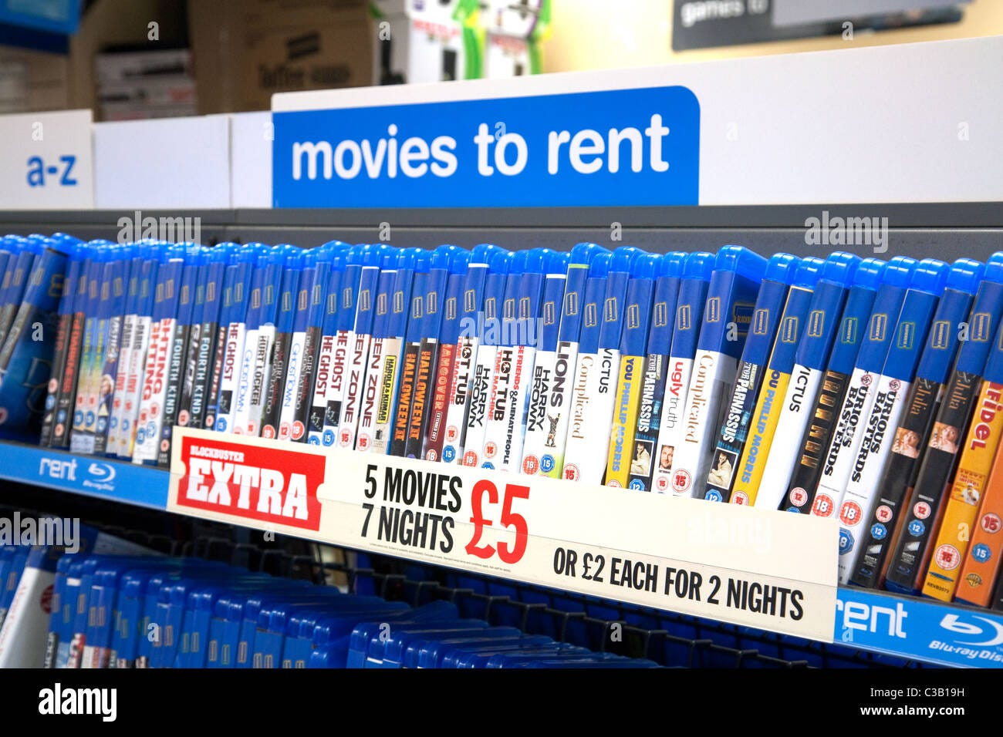

Exploratory Data
Analysis
SQL

Slide 4
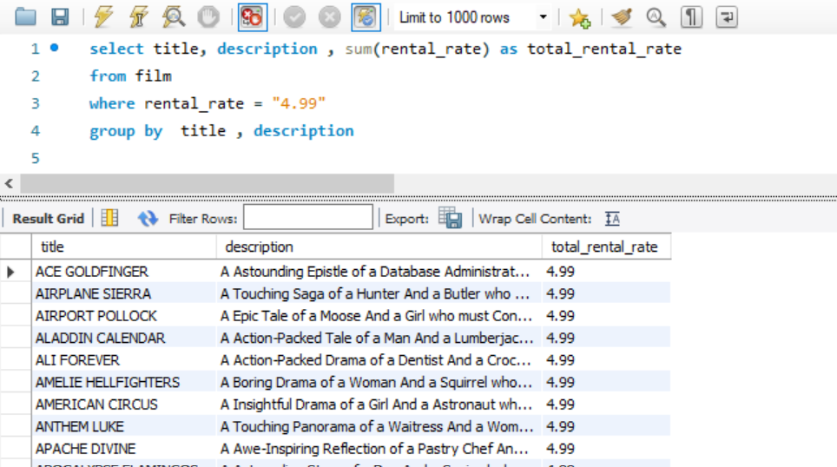
Which films have the highest rental rates and are most in demand?
The films which has highest rental.
This query will give us all the movies which have highest rental and are most in demand
Total 336 movies has the highest rental rate which “4.99”

Slide 5
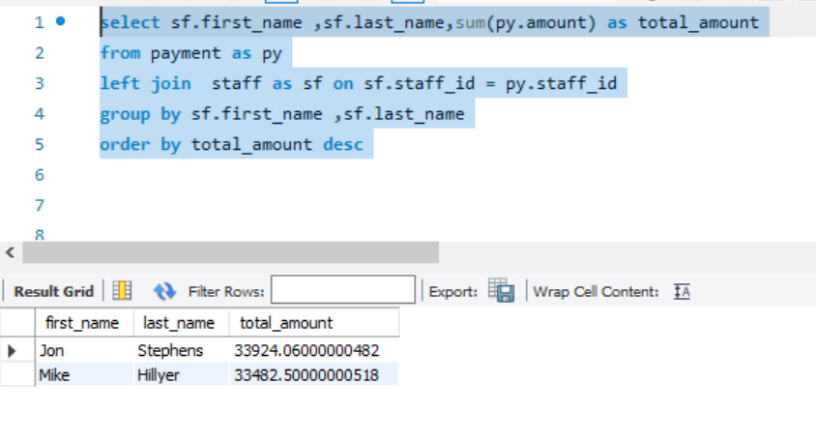
Are there correlations between staff performance and customer satisfaction?
Staff Performance this are some staff members who have performed well.
The total_amount represent the sales of the staff members
This will give you the performance of the staff
Here “Jon Stephens” has made highest sales of 33,924

Slide 6
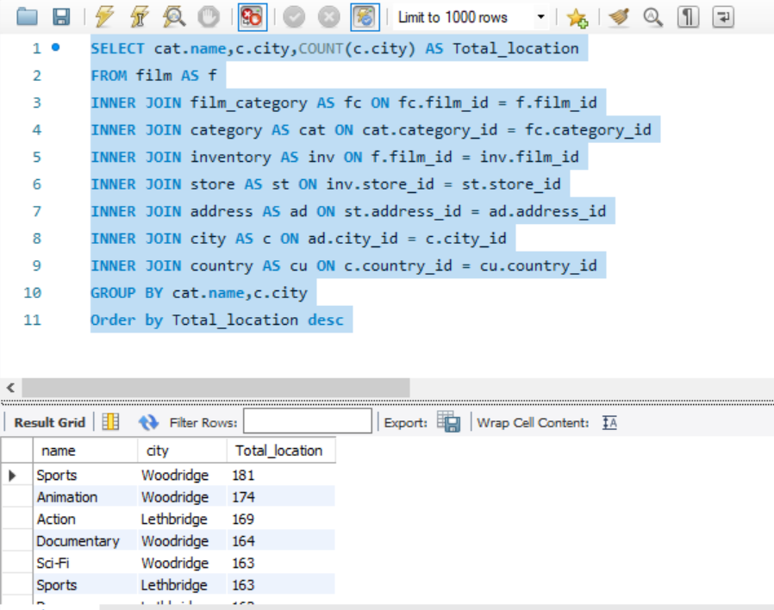
Are certain film categories more popular in specific locations?
This are some popular films category in specific locations.
Sports category has the most popularity in both city Woodbridge and Lethbridge which is total 344.
Animation has the second most popularity in both city Woodbridge and Lethbridge which is total 335
Row Labels | Lethbridge | Woodridge | Grand Total
Action | 169 | 143 | 312
Animation | 161 | 174 | 335
Children | 129 | 140 | 269
Classics | 131 | 139 | 270
Comedy | 142 | 127 | 269
Documentary | 130 | 164 | 294
Drama | 162 | 138 | 300
Family | 157 | 153 | 310
Foreign | 153 | 147 | 300
Games | 128 | 148 | 276
Horror | 112 | 136 | 248
Music | 122 | 110 | 232
New | 148 | 127 | 275
Sci-Fi | 149 | 163 | 312
Sports | 163 | 181 | 344
Travel | 114 | 121 | 235
Grand Total | 2270 | 2311 | 4581

Slide 7
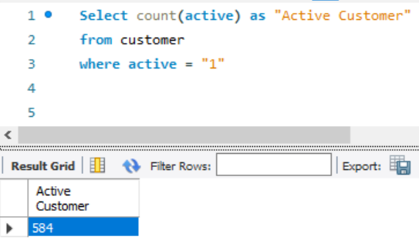
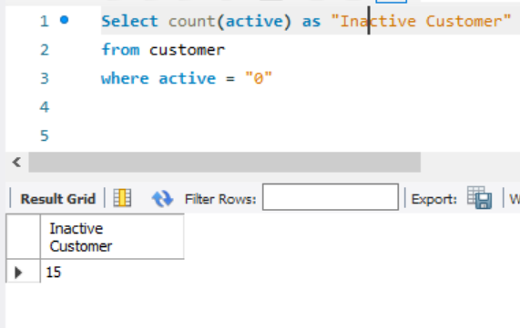
Number of Active & Inactive customers
This query will give you number of active and Inactive Customer.
This table shoes that the number of active customer are more which means we can focus on the preference of the active users.
We need to take feedback of the Inactive user which will helps us to regain those customer again.

Slide 8
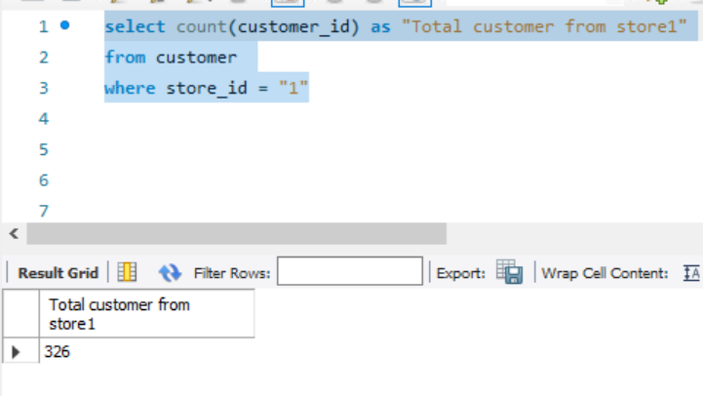
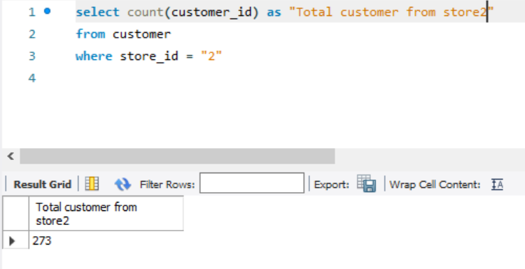
Total customer from Store 1 & 2
This query will give you number of total number of customer each store have.
Store has the large number of customer which is “326”
Because of this number we can clearly make the decision what are the steps store 1 is taking so that they have large numbers of customers.

Slide 9
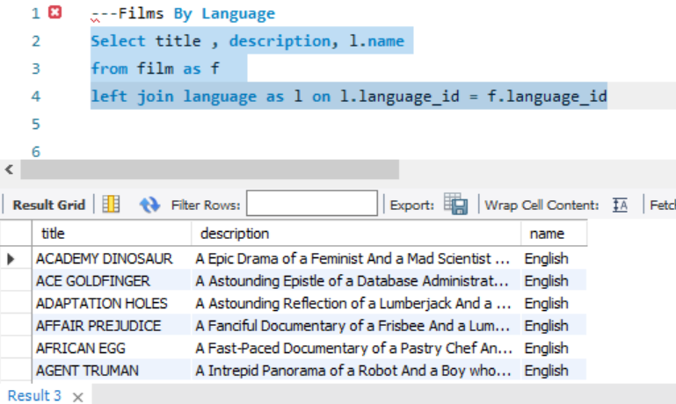
Films By Language
There are total 1000 films with the language English
This language is mainly selected by the customers

Slide 10
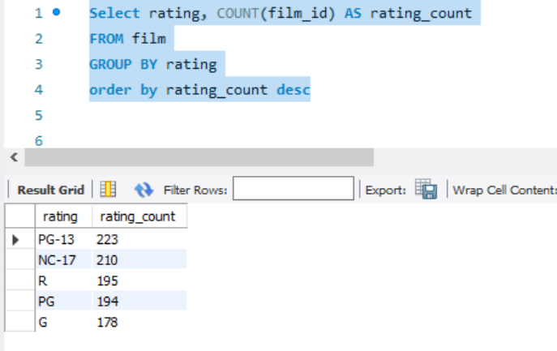
Total Films By Rating
Total films by Different rating
PG-13 has the highest number of films which is “223”
NC-17 has the second highest number of films which is “210”
By knowing customer demand Films rating can helps us to increase the inventory volume which customer love to watch according to rating.

Slide 11
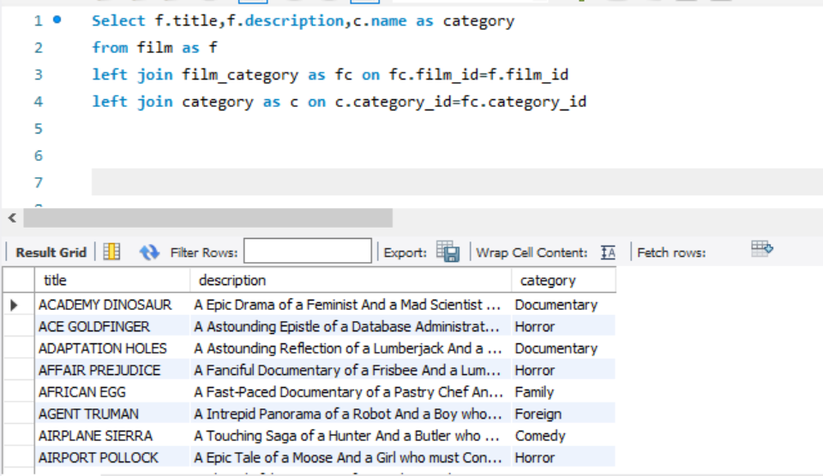
Films with category
Films with the category
Sports has the highest numbers of films which is “74”
This analysis gives the idea category films need to be add more
Category Name | Number of films
Sports | 74
Foreign | 73
Family | 69
Documentary | 68
Animation | 66
Action | 64
New | 63
Drama | 62
Games | 61
Sci-Fi | 61
Children | 60
Comedy | 58
Classics | 57
Travel | 57
Horror | 56
Music | 51
Grand Total | 1000

Slide 12
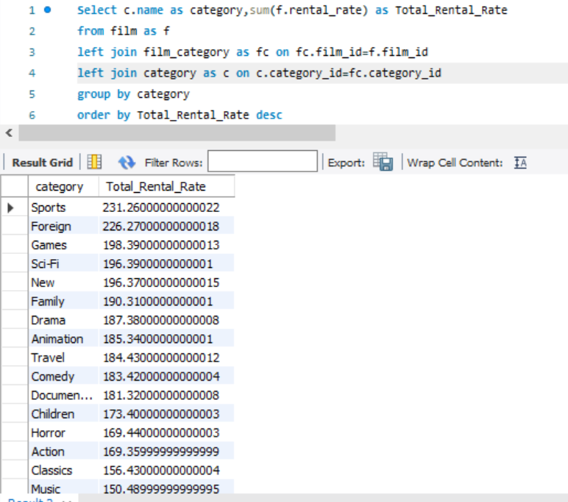
Total rental rate category
Here this analysis give the maximum earnings earns by the category of the film.
The “Sports” give us the highest earning which means our customer loves watching documentary films more than other category.
We can take decision upon which category films needs to add more so that revenue can earn more.

Slide 13
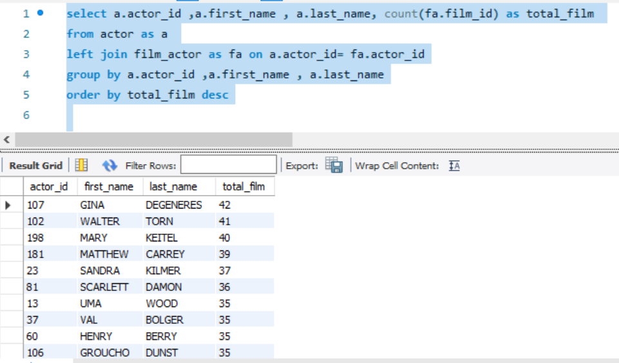
Highest films done by an actor
Highest film done by an actor
The actor which has done highest films is “GINA DEGENERES” which has done “42” films.
Our inventory have maximum films of this actor now we can take decision on the popularity of this actor whether we should add more film for him.

Slide 14
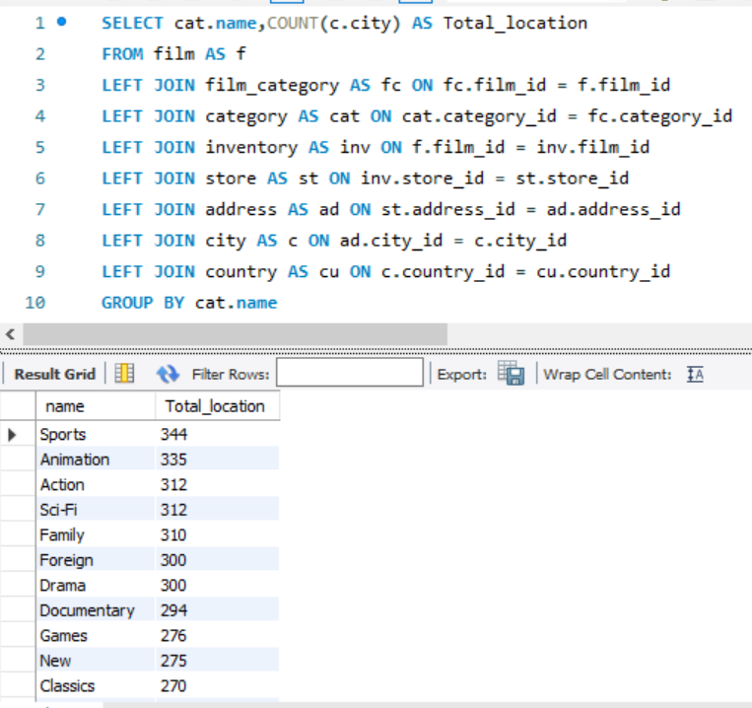
Total film categories by location
Total films category by the location
The “Sports” category has the highest no of the location available.
The “Animation” category has the second highest no of location available
This analysis show the film category which is widely available in the location, We need to focus on the category which has least number of location have.

Slide 15
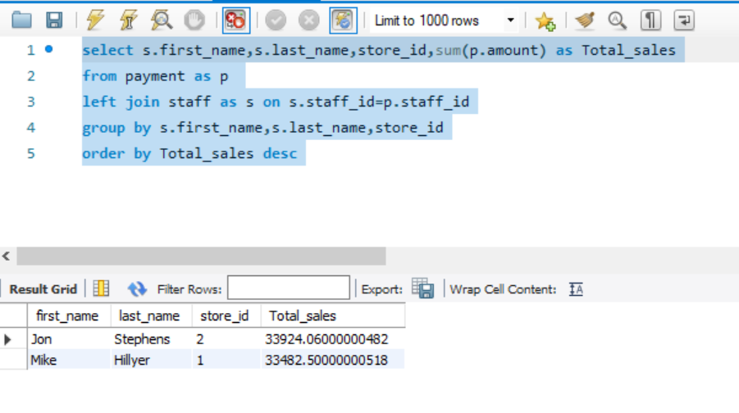
Highest sales of stores with staff members
Highest sales of the store with staff
“Jon Stephens” has made the highest sales which work in store number “2” the total sales made is 33,924
Where “Mike Hilyer” has made sales of 33,482 from store “1”.
This analysis give the report that Jon is using some technics which helping him to gain more sales or may be there is something where Mike is lagging need to figure out where is the problem.

Slide 16
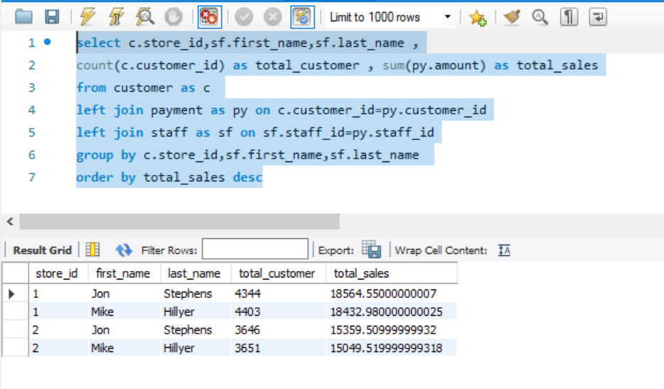
Total sales of stores with staff and total customers
Total sales of stores with staff and total customers
The Store 1 has made sales more than store 2.
This analysis show the clarity that the reason of store 1 made more sales than store 2 is the customer.
That means to increase sales of store 2 needs to increase customer.

Slide 17
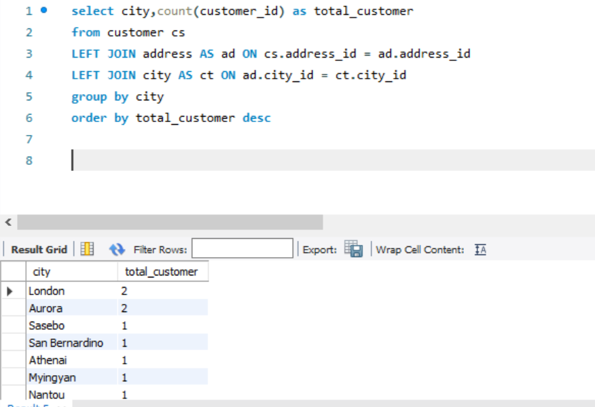
Highest numbers of customer in a city
Maximum number of customer comes from which city
The London and Aurora is the city which have maximum numbers of customer
We need to focus on more city to increase our customer which will help us to increase in sales

Slide 18
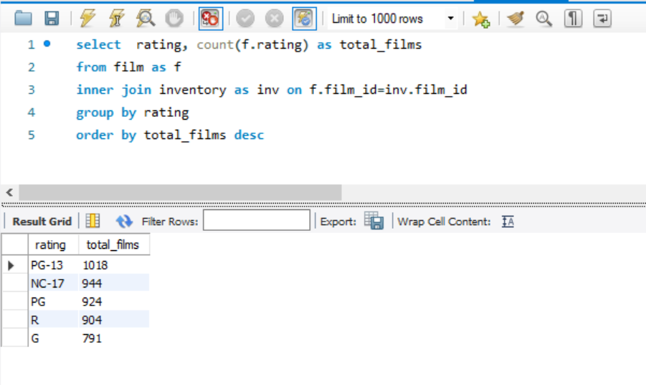
Total Films available in inventory by rating
Films available in inventory by rating
PG-13 has the highest number of films in inventory which is “1018”
We need to focus on the other rating which has least number and increase the number to available more films in inventory.

Slide 19

Data
Analysis
Power BI

Slide 20
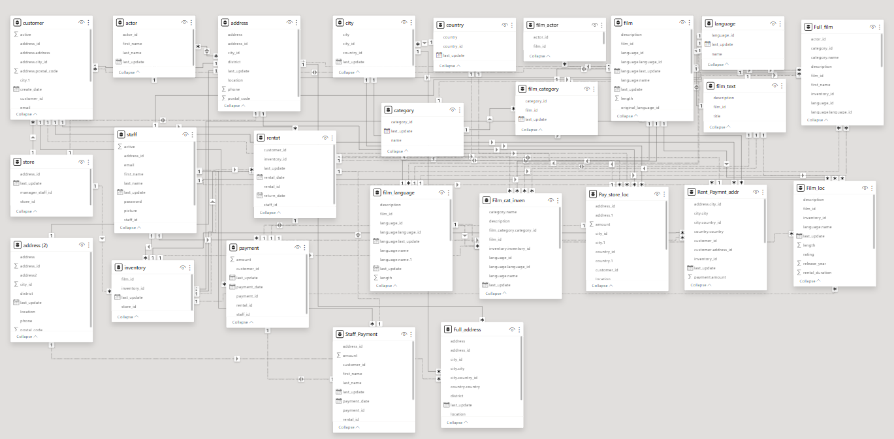
ER DIAGRAM

Slide 21
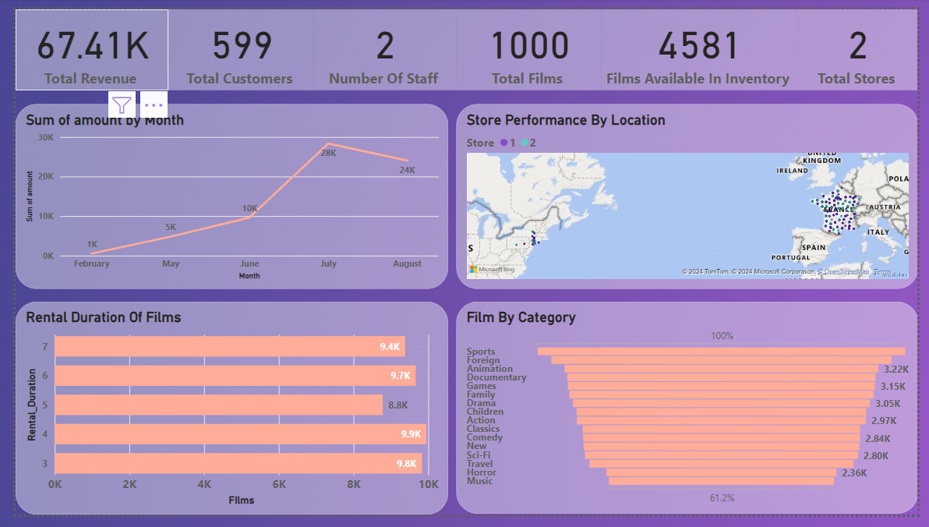

Slide 22
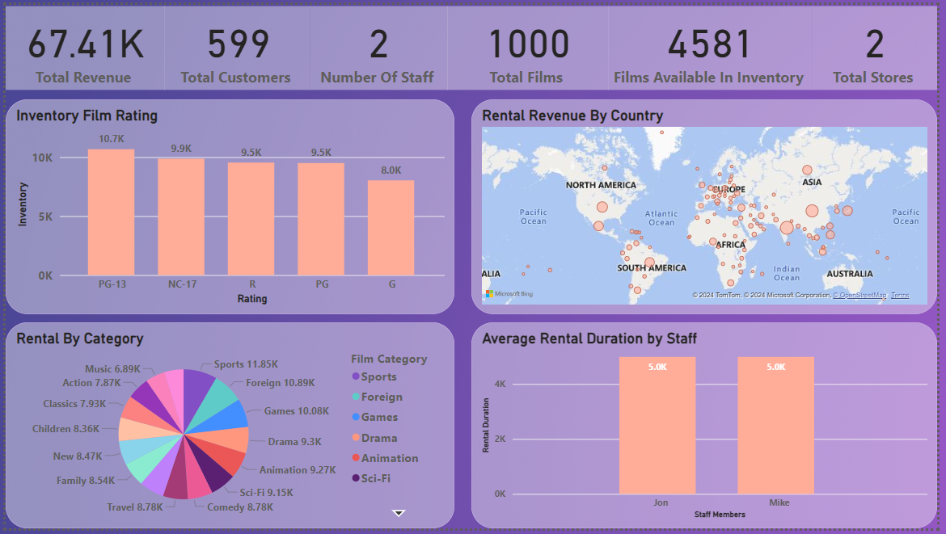

Slide 23
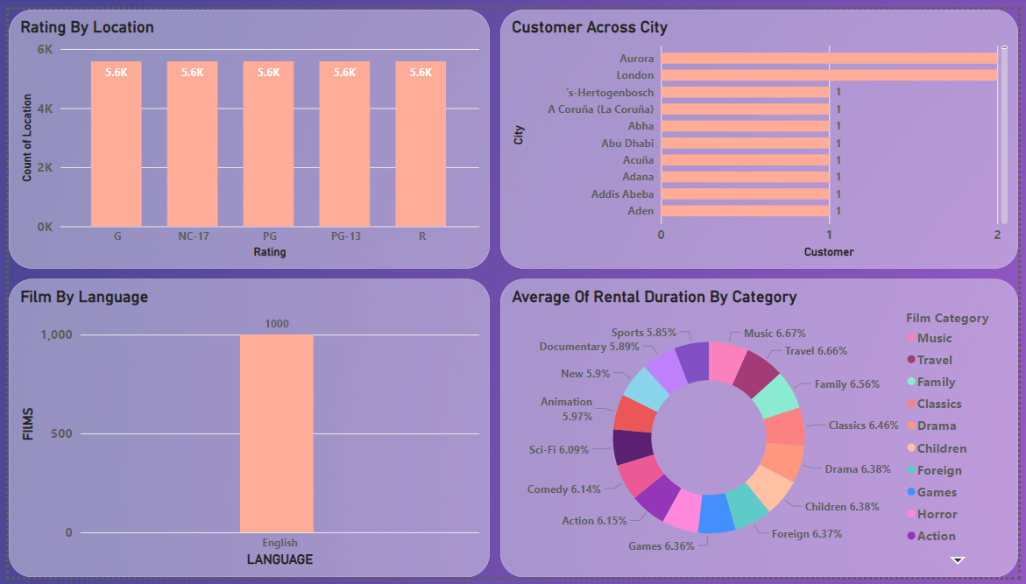

Slide 24
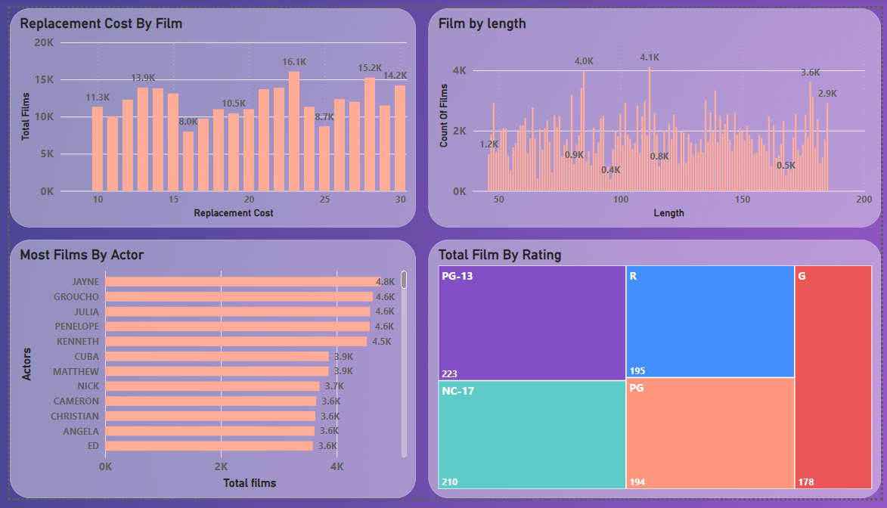

Slide 25
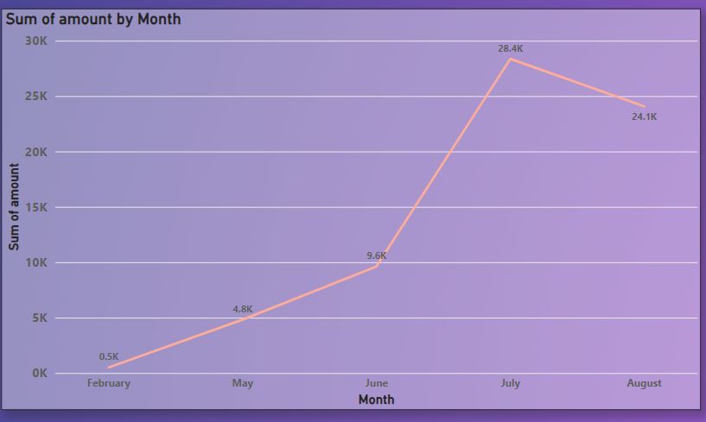
How does the sales revenue vary by month?
Sales Revenue by month
This shows us that the July month has the peak in sales.
By this analysis we can discuss upon the other scenario for the month of July.

Slide 26
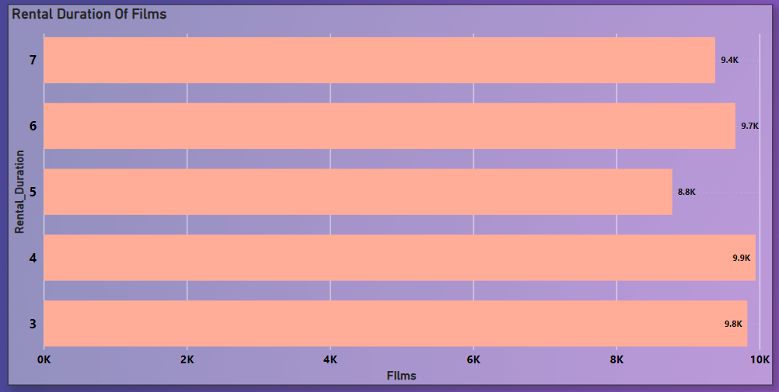
What is the distribution of films by rental duration?
This chart shows us that the rental duration of the films.
The maximum number of movie we have is of 4 minutes.

Slide 27
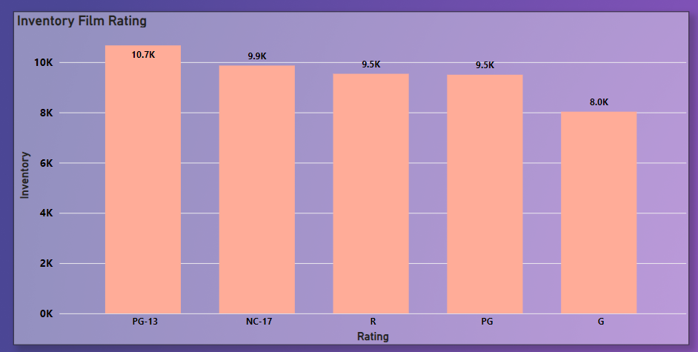
How does the inventory vary by film rating?
Films available in Inventory by different rating
Rating “PG-13” has the highest no of films
By knowing customer demand Films rating can helps us to increase the inventory volume which customer love to watch according to rating.

Slide 28
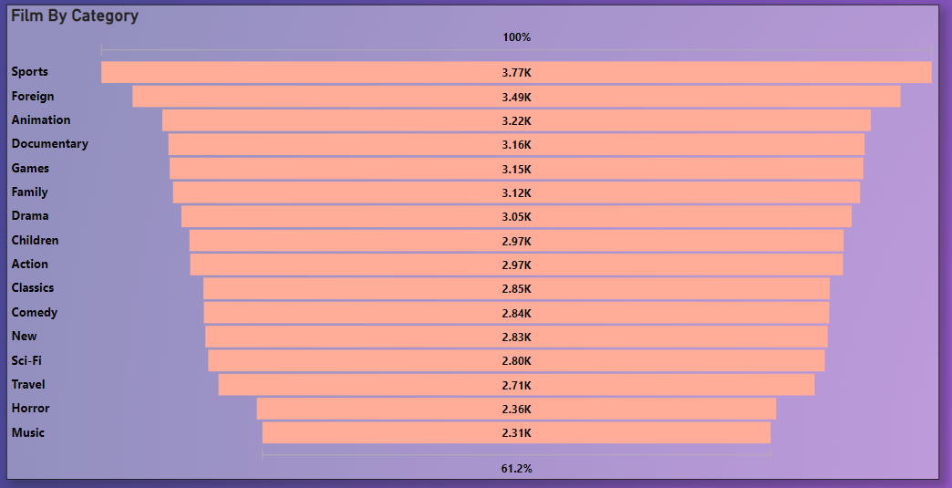
What is the breakdown of film categories in the inventory?
Different Film category and the numbers available in inventory
The “Sports” category have the maximum numbers of films.
Now, Inventory needs to be update by the least numbers of category.
We can update the inventory as per customer demand as well.

Slide 29
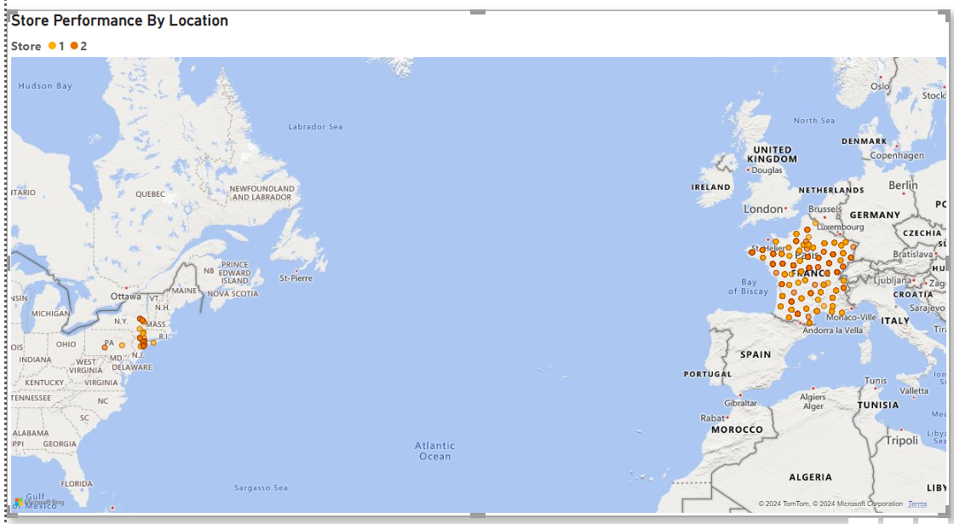
How does the store performance vary by location?
Store performance by the location.
The store 1 and store 2 are equal performer.
Both stores have maximum performance in France and some other region of USA as well.

Slide 30
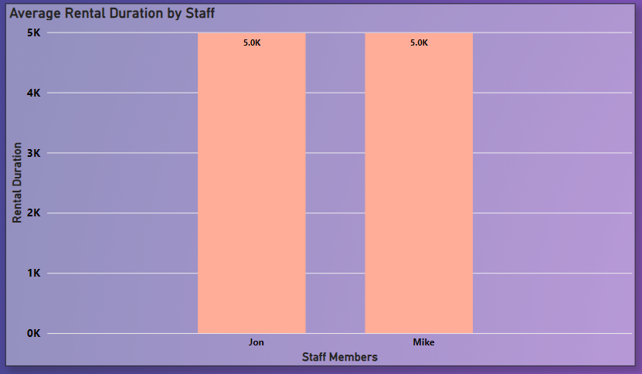
What is the average rental duration by staff member?
The average rental duration of the staff.
The average rental duration of the both staff is equally.

Slide 31
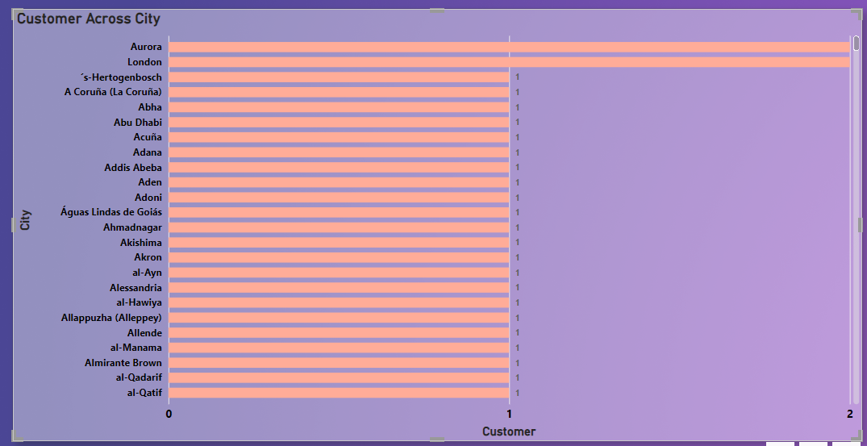
What is the distribution of customers across different cities?
Number of customers across different city
Aurora and London is the only city which maximum numbers of customers that is also “2”

Slide 32
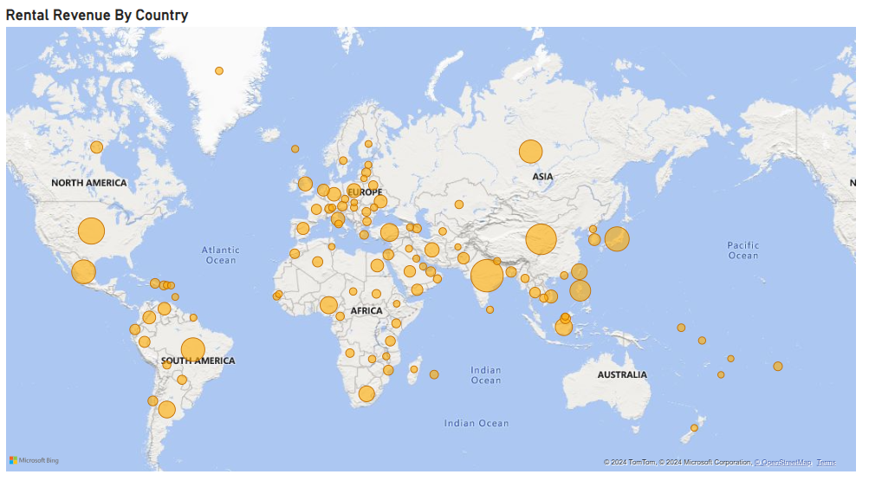
How does the rental revenue vary by country?
Rental revenue earned by the countries.
Here “India” has earned the maximum revenue from rent which is “6,628”
We need to find the number of customer which is same to India this will give us the other country name where we need to focus on rental revenue.

Slide 33
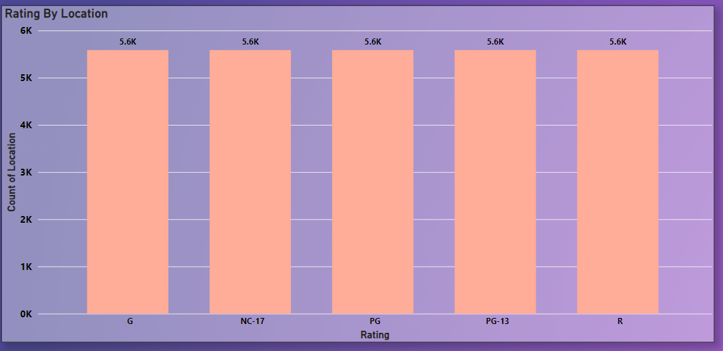
Which locations have the highest and lowest customer ratings?
The customer rating are equal to all location.

Slide 34
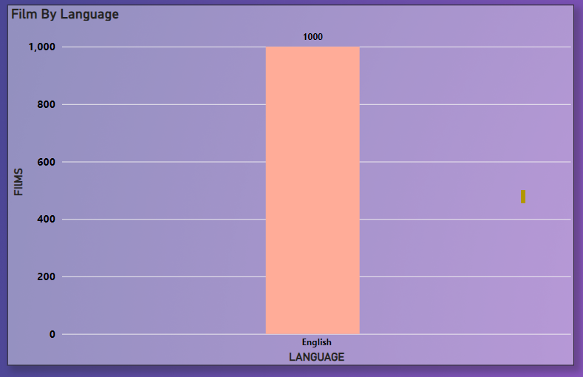
What is the distribution of films by language?
There is only one language of films we have that is “English”.
We need to add others language of films as well which will give us extra revenue and will target the other audience as well.

Slide 35
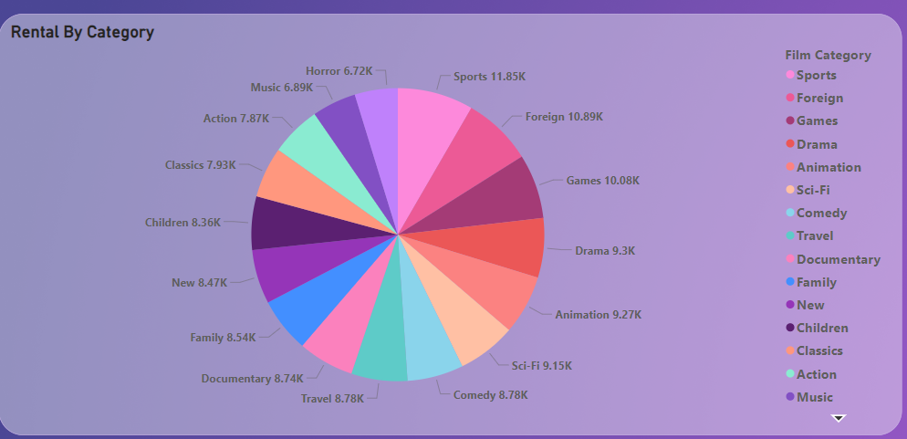
Which film categories have the highest rental rates?
The “Sports” category have the highest number of the Rental rate which is “11,850”.

Slide 36
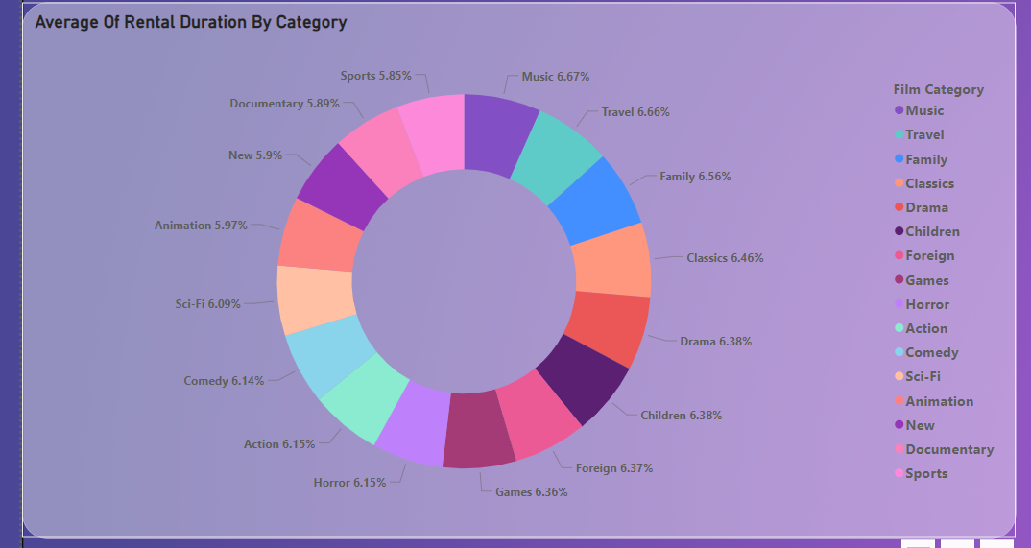
How does the average rental duration vary by film category?
The average rental duration of the films.
The maximum average rental duration of film category is “Music”.

Slide 37
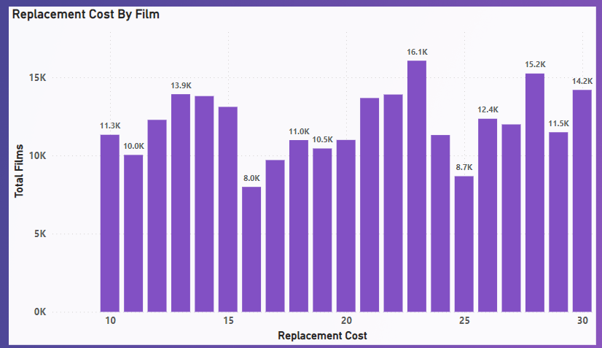
What is replacement cost by film ?
This is the replacement cost of the films.
The Maximum number of films which have replacement cost of “22.97”. There are total 16,064 films which have this cost.
The lowest number of films which have replacement cost of “15.99”. There are total 7,993 films which have this cost.

Slide 38
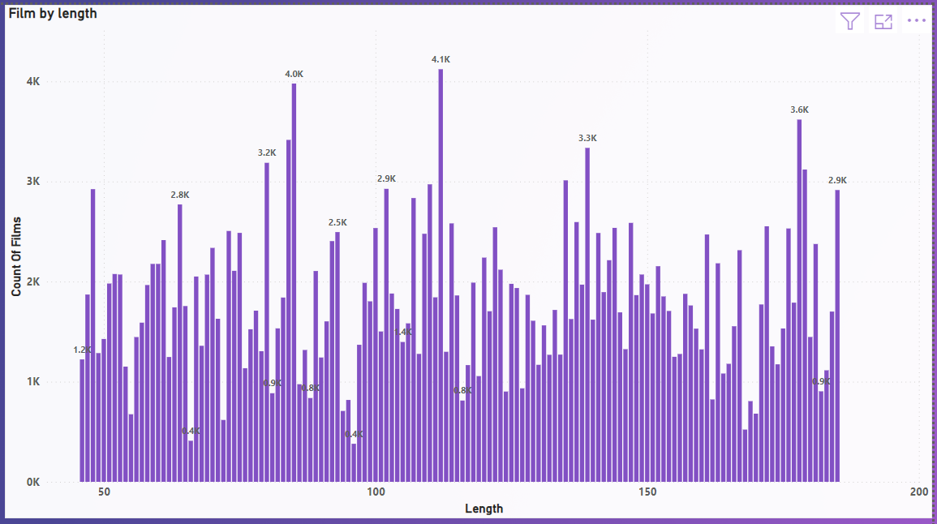
What is the distribution of films by length ?
This is the distribution of the total films with their length.
The number of films which have maximum length is 112 Minutes and they are total 4122 films.
The least number of films is of 96 minutes and they are total 380 films.

Slide 39
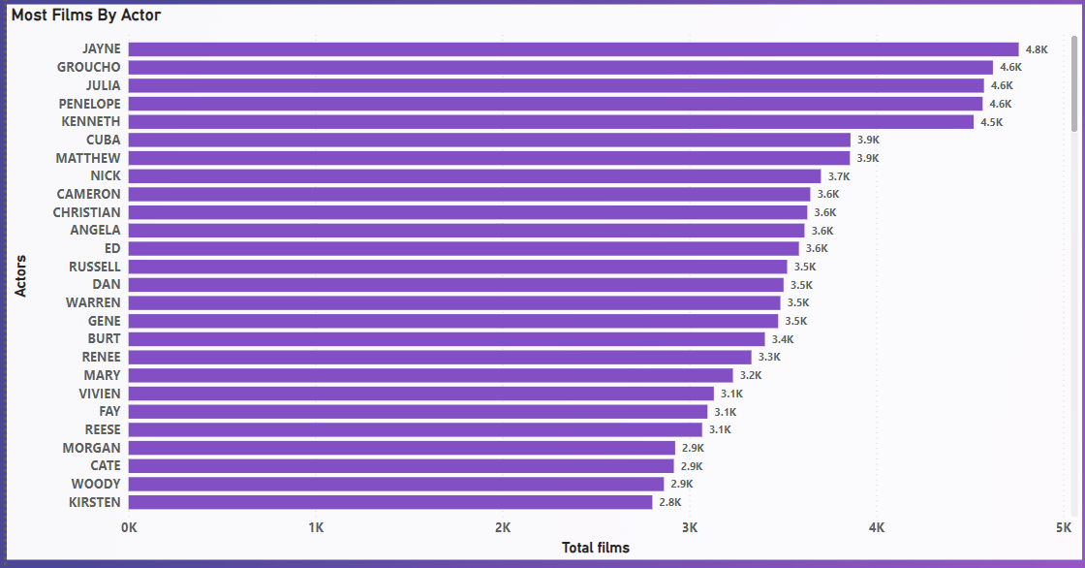
Most Films done by an actor ?
Films done by actors.
The Highest number of films done by an actor is “JAYNE” which 4.8k

Slide 40
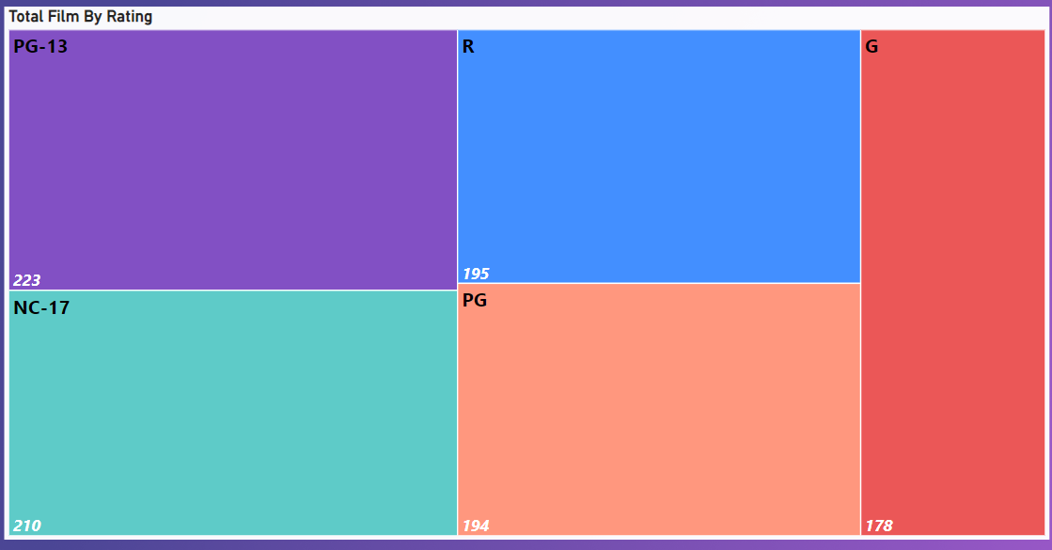
Total Films by rating ?
Total films by rating
Maximum films have PG-13 rating which is “223”

